Slide 1

Department of Information Technology
NBA Accredited A.P. Shah Institute of Technology G.B.Road, Kasarvadavli, Thane(W), Mumbai-400615 UNIVERSITY OF MUMBAI Academic Year 2021-2022

Slide 2
A Project Report on Implementing AI Based Comprehensive Web Framework for Tourism Submitted in partial fulfillment of the degree of Bachelor of Engineering (Sem-8) in INFORMATION TECHNOLOGY By Nada Rajguru(19204005) Jaynam Shah(18104047) Harsh Shah(18104072) Under the Guidance of Prof. Anagha Aher
Prof. Nahid Shaikh

Slide 3
1.Project Conception and Initiation

Slide 4
1.1 Abstract
The smart tour recommender is a web based framework for facilitating tourists through tour planning.
Unlike other similar web-based systems, our system streamlines all the processes required for travel planning making it easy and convenient to use.
It focuses on making e-tourism easier and convenience through recommendations using machine learning, as more and more people use such travel websites to plan their trips.

Slide 5
1.2 Objectives
To develop an extensive web portal that provides tourists/users with hotel booking and flight booking.
To design a recommendation system that will suggest tours and hotels.
To implement an AI chatbot for customer support and solve basic queries.
To provide a forum to dissolve any problems and communicate with users/customers.

Slide 6
1.3 Literature Review
In relation to the industry and recommendation, the context can be defined as the characteristic information of an entity such as users or object.
The contextual information can be helpful to personalize recommendations on tours and places as suggested by Thomas and John.
According to Adomavicius and Tuzhilin, the dependability factor of various recommendation algorithms is determined by their data qualities.

Slide 7
1.3 Literature Review
Yoke Cheng and Noor Raihan describes the understanding of the web surfer’s behaviour and preferences to allow the travel and tourism service providers to strategize their businesses effectively.
The authors propose the utilization of a mixed hybrid recommendation technique including demographic, content-based recommendations, preference-based filtering to travel and tourism service providers

Slide 8
1.4 Problem Definition
Increasingly tourists are planning trips using the abundant information available on the web, however they still expect and want trip plan advisory services.
Booking for hotels as per user preferences and flights can be tedious and time consuming as travellers have to visit multiple websites researching for their preferred choices;
And finding appropriate hotels closer to airports or certain destinations can be arduous

Slide 9
1.5 Scope
The proposed system provides users with hotel booking and flight booking.
The system also implements a recommendation system which provides users with hotel recommendations as per user preferences.
An AI chatbot is also provided to users for quick responses and customer support to solve basic queries.
A forum is also provided to users for customer support and solving any queries

Slide 10
1.6 Technology stack
Frontends & Frameworks-
HTML, CSS, JS
Backend & AI/ML-
Flask
Pandas, numpy
NLTK (Natural Language Toolkit)
Database -
MongoDB

Slide 11
1.7 Benefits for environment & Society
The system provides easy access to information on tourism services.
Reduces on-screen time for users searching for different hotels/places as the system provides personalized recommendations based on user preferences.
Thus improving user experience and providing user with various features to find a suitable hotel as per users needs.
AI chatbot provides quick responses to users queries improving the conversational user experience and providing customer support.

Slide 12
2. Project Design

Slide 13
2.1 Proposed System
The system we proposed mainly provides users with hotel booking and flight booking features.
Hotel booking is prioritized and recommended to the user based on user preferences and previous travel history.
The recommendation system takes into consideration these preferences and provides the user with hotels that match the user preferences.
The system also provides an AI chatbot and a forum, with the help of which users can solve their queries.

Slide 14
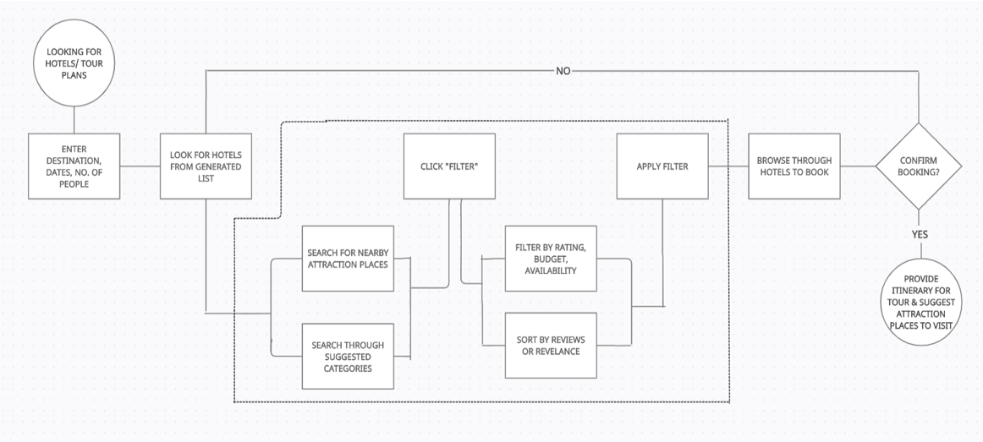
2.1 Proposed System

Slide 15
2.2 Design(Flow Of Modules)
The user can complete signup process (if user already doesn’t have an account) and then login into the system.
The system will ask input for user preferences to create a model to provide user with recommendations.
The user can then select an appropriate hotel by applying required filters and complete the booking process.
Similarly, user can complete the flight booking process.
The user can connect with AI chatbot provided to solve any basic queries.
The user can also connect on the forum provided to solve any other queries.

Slide 16
2.3 Description of Use Case
After a user completes sign-up process and is logged in the user inputs the data/preferences which will be used for recommendation.
The user can then search for hotels and as per the given preferences hotels are recommended; after selecting a hotel the user can complete the booking process.
User can also book flights by inputting the required information.
User can communicate with the AI chatbot which provides quick response to solve basic queries.
User can also connect through forum provided to solve any other queries

Slide 17
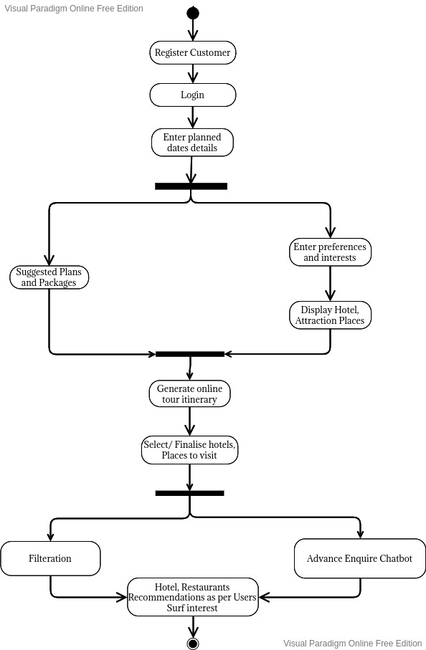
2.4 Activity diagram

Slide 18
3. Implementation

Slide 19
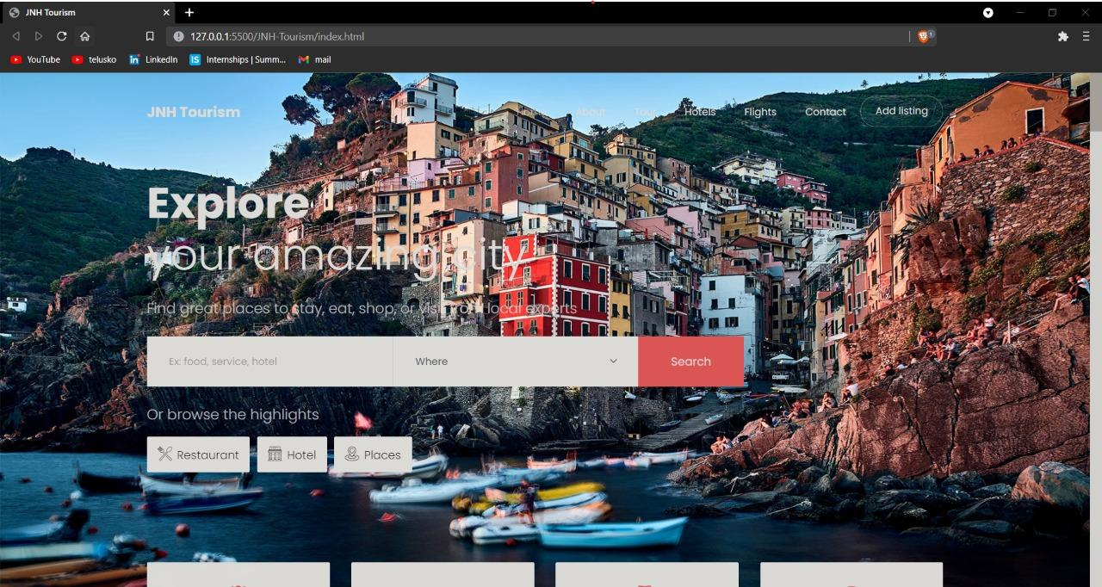

Slide 20
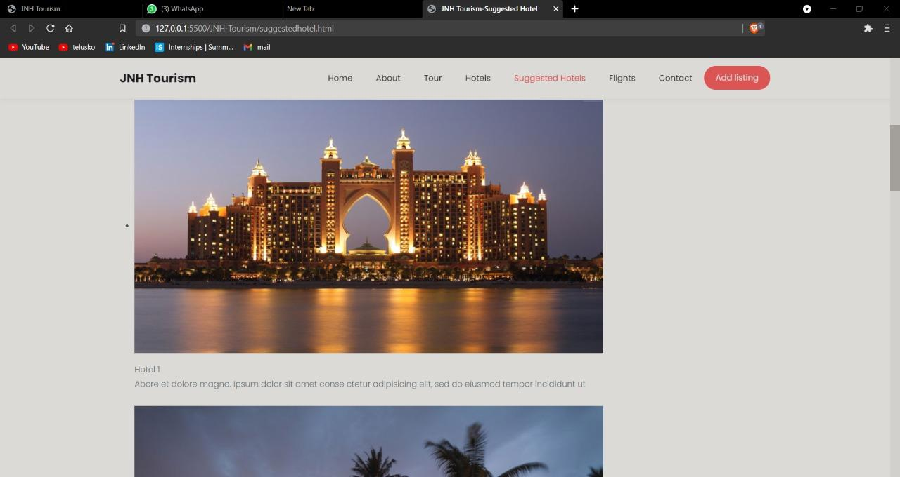

Slide 21
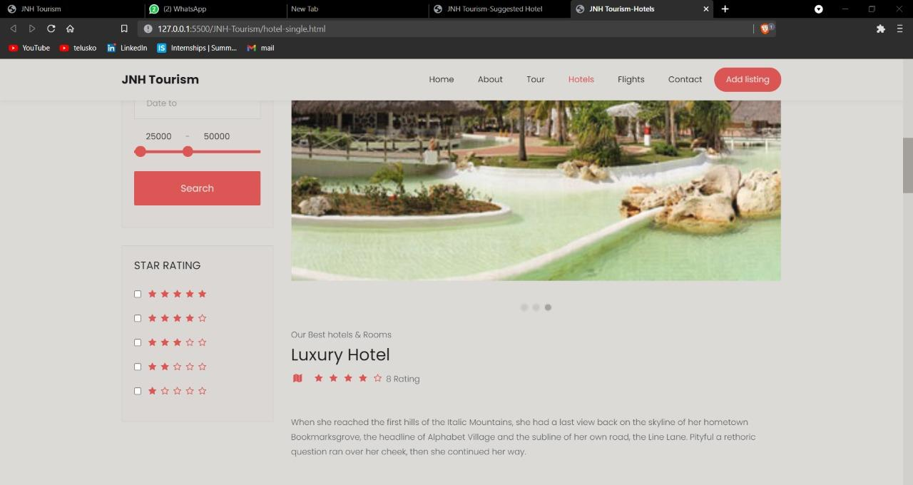

Slide 22
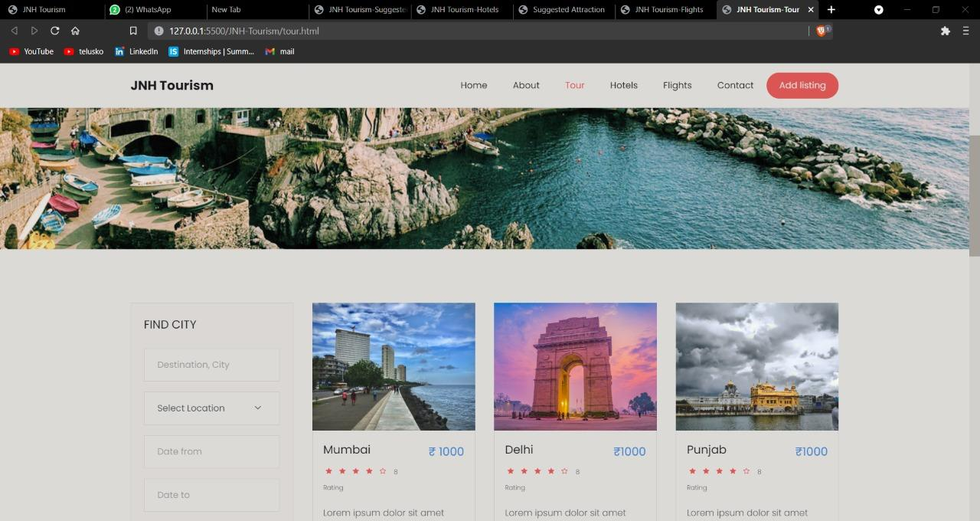
3. Implementation

Slide 23
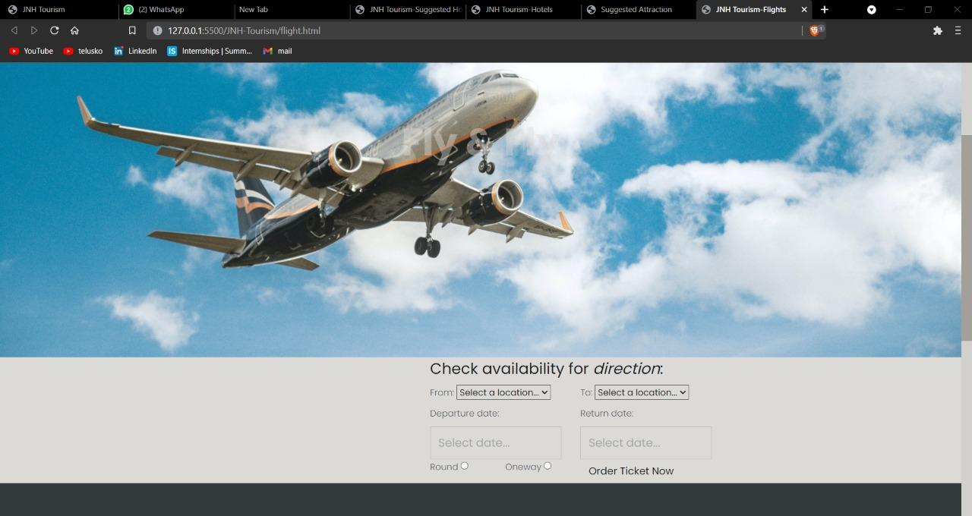
3. Implementation

Slide 24
4. Testing

Slide 25
Functional Testing
Unit Testing :
Unit testing is the first level of testing and is often performed by the developers themselves. It is the process of ensuring individual components of a piece of software at the code level are functional and work as they were designed to. Developers in a test-driven environment will typically write and run the tests before the software or feature is passed over to the test team. Unit testing can be conducted manually. Unit testing will also make debugging easier because finding issues earlier means they take less time to fix than if they were discovered later in the testing process.
After each unit is thoroughly tested, it is integrated with other units to create modules or components that are designed to perform specific tasks or activities.

Slide 26
Functional Testing
Unit Testing :
These are then tested as group through integration testing to ensure whole segments of an application behave as expected (i.e., the interactions between units are seamless). These tests are often framed by user scenarios, such as logging into an application or opening files. Integrated tests can be conducted by either developers or independent testers and are usually comprised of a combination of automated functional and manual tests.
Unit tests help to fix bugs early in the development cycle. It helps us to understand the testing code base and enables to make changes quickly. Unit tests also helped with code reuse and to Migrate both our code and our tests to our new project.

Slide 27
5. Result

Slide 28
6. Conclusion and Future Scope

Slide 29
In this project we have created an e-tourism website that allows users to find hotels suited to user’s budget and preferences, and providing with hotel booking and flight booking.
The project implements a recommendation system to search for hotels as per user preferences and previous travel history. An AI chatbot is also implemented to improve user experience and provide quick support and responses to user queries.

Slide 30
As AI/ML is employed for analysis and solution generation, the framework will become quicker and more efficient. It will allow customers to reserve trains, automobiles, planes, and other kinds of transportation.
A system can collaborate with hotels, restaurants, and other eateries to promote and highlight them on the site. If a recommendation system can be developed based solely on considering the visual content of the video, it would become the most accurate recommender system. A more realistic step towards achieving this can be to develop a model that could make recommendations according to the visual content of the video shorts instead of the whole video. This could also ensure that the recommended list varies according to the latest trends in video content.

Slide 31
References
Barranco M.J., Noguera J.M., Castro J., Martínez L. (2012). A Context-Aware Mobile Recommender System Based on Location and Trajectory. In: Casillas J., Martínez-López F., Corchado Rodríguez J. (eds) Management Intelligent Systems. Advances in Intelligent Systems and Computing, vol 171. Springer, Berlin, Heidelberg.
Adomavicius G., Tuzhilin A. (2011) Context-Aware Recommender Systems. In: Ricci F., Rokach L., Shapira B., Kantor P. (eds) Recommender Systems Handbook. Springer, Boston, MA.
Aw Yoke Cheng, & Ab Hamid, N. R. (2011). Behaviour and preferences in browsing the travel and tourism websites. 2011 IEEE Colloquium on Humanities, Science and Engineering.

Slide 32
References
Pazzani M.J., Billsus D. (2007) Content-Based Recommendation Systems. In: Brusilovsky P., Kobsa A., Nejdl W. (eds) The Adaptive Web. Lecture Notes in Computer Science, vol. 4321. Springer, Berlin, Heidelberg.
De Nart D., Ferrara F., Tasso C. (2013) Personalized Access to Scientific Publications: from Recommendation to Explanation. In: Carberry S., Weibelzahl S., Micarelli A., Semeraro G. (eds) User Modeling, Adaptation, and Personalization. UMAP 2013. Lecture Notes in Computer Science, vol 7899. Springer, Berlin, Heidelberg.
Jafri, R., Alkhunji, A. S., Alhader, G. K., Alrabeiah, H. R., Alhammad, N. A., & Alzahrani, S. K. (2013). Smart Travel Planner: A mashup of travel-related web services. 2013 International Conference on Current Trends in InformationTechnology (CTIT).

Slide 33
Paper Publication
Paper entitled Implementing AI Based Comprehensive Web Framework for Tourism is presented at Springer ICTIS 2022

Slide 34
Thank You

